Slide 1
CIS8695 Managing Big Data Analytics
Nasim Mousavi
Assistant Professor
J. Mack Robinson College of Business
Georgia State University
nmousavi@gsu.edu

Slide 2
Performance Evaluation

Slide 3
Why Evaluate?
Multiple methods are available to classify or predict
For each method, multiple choices are available for settings
To choose best model, need to assess each model’s performance

Slide 4
Outcomes of Interest
Numerical value
Membership in a class
“Propensity” - probability of belonging to a class

Slide 5
Measuring Predictive Error-Numerical Value
Not the same as “goodness-of-fit”
We want to know how well the model predicts new data, not how well it fits the data it was trained with
Key component of most measures is difference between actual y and predicted y (“error”)

Slide 6
Some Measures of Error
MAE or MAD: Mean absolute error (deviation)
Gives an idea of the magnitude of errors
Average error
Gives an idea of systematic over- or under-prediction
MAPE: Mean absolute percentage error
RMSE (root-mean-squared-error): Square the errors, find their average, take the square root
Total SSE: Total sum of squared errors

Slide 7
Lift Chart for Predictive Error
Similar to lift chart for classification, except…
Y axis is cumulative value of numeric target variable (e.g., revenue), instead of cumulative count of “responses”

Slide 8
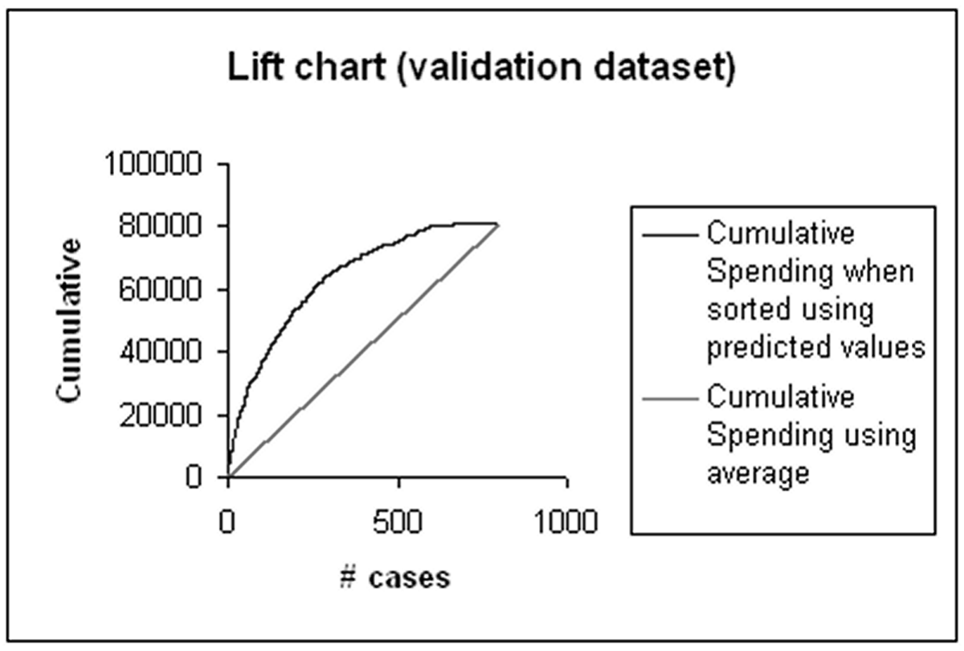
Lift Chart Example – Spending

Slide 9
Accuracy Measures (Classification)

Slide 10
Misclassification Error
Error = classifying a record as belonging to one class when it belongs to another class.
Error rate = percent of misclassified records out of the total records in the validation data

Slide 11
Performance Measures
If 1 is the True class, 0 is the other class
Sensitivity = % of class 1 correctly classified
Specificity = % of class 0 correctly classified
False positive rate = % of predicted 1 that were actually 0
False negative rate = % of predicted 0 that were actually 1

Slide 12
Confusion Matrix
Some common metrics:
Accuracy = (True positive + true negative) / (total)
Precision = (True positive) / (predicted positive)
Recall = (True positive) / (actual positive) – also known as sensitivity
Specificity= (True negative) / (actual negative)
Actual | Predicted
 | Positive, 1 | Negative, 0
Positive, 1 | True Positive | False Negative
Negative, 0 | False Positive | True Negative

Slide 13
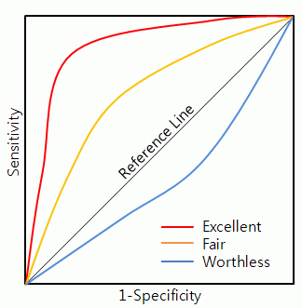
ROC Curve
ROC (receiver operating characteristics) curve
Plot the pair {Sensitivity, 1-Specificity} as the cutoff value increases from 0 to 1
The diagonal line reflects the performance of the naïve rule using varying cutoff values
The larger the area under the ROC curve, the better is the classifier.

Slide 14
Lift (Gain) Chart
Similar idea to ROC curve, but measuring “how much does the model improve on random chance in finding the class of interest”
Evaluates how well a model identifies the most important class compared to the random chance or a cut-off value
By comparing the lift scores for different models, you can determine which model is best
You can also determine the point at which the model's predictions become less useful

Slide 15
Lift (Gain) Chart
Using Lift Chart to estimate the response to a targeted mailing campaign
A marketing department knows that a 10 percent response rate is more or less typical of mailing campaigns
They have a list of 10,000 potential customers stored in a table in the database
Based on the typical response rate, they could normally expect only about 1,000 of the potential customers to respond
However, the money budgeted for the project is not enough to reach all 10,000 customers, only for 5,000 ones in the database, and they want to improve their response rate

Slide 16
Lift (Gain) Chart
The marketing department has two options:
Randomly select 5,000 customers to target
Use a mining model to target the 5,000 customers who are most likely to respond
By using a lift chart, you can compare the expected results of both options

Slide 17
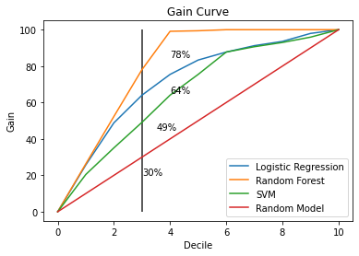
Lift (Gain) Chart

Slide 18
Lift Chart vs. ROC Curve
Gains and ROC curves have similar appearance
ROC curve and AUC provide a widely used single metric and visual to assess a model’s ability to separate classes overall
Lift (gains) yields intuitive measure of model performance at different cutoffs, but no overall metric

